Slide 1
Microsoft Fabric Community Conference Holding Slide

Slide 2

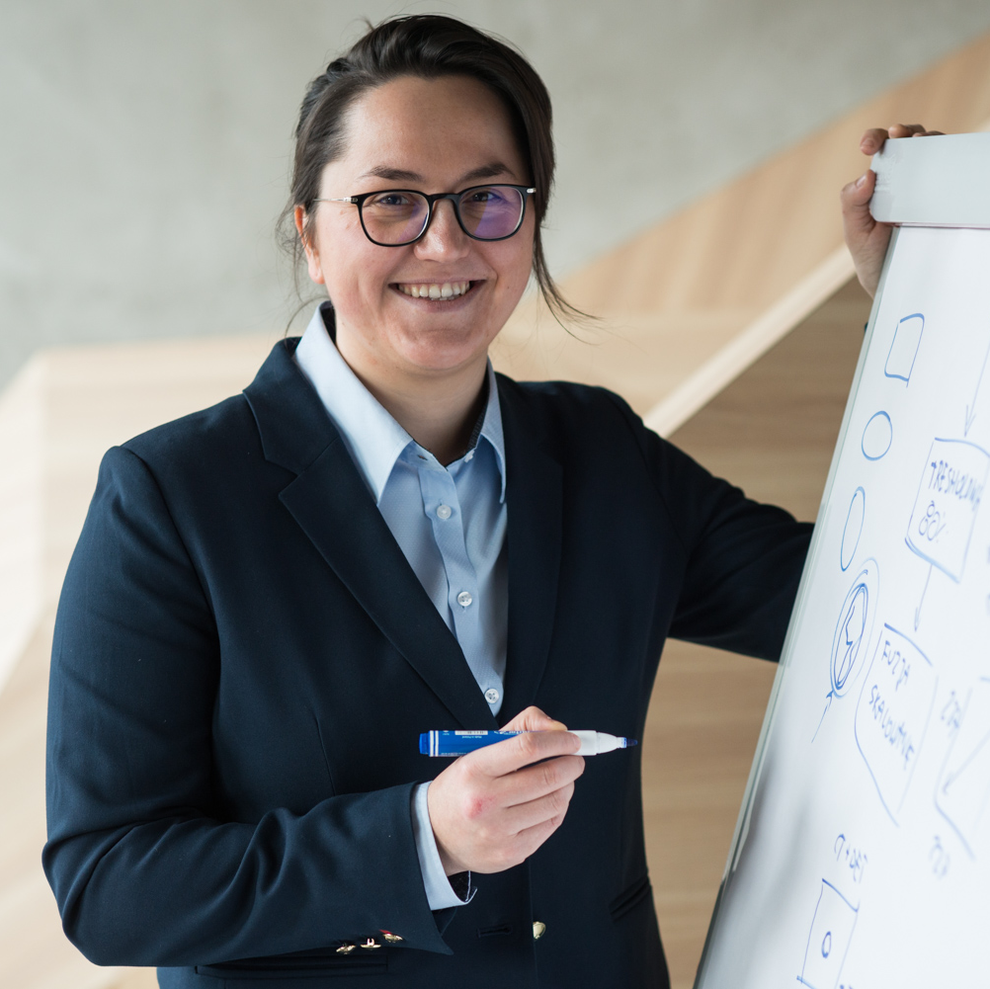
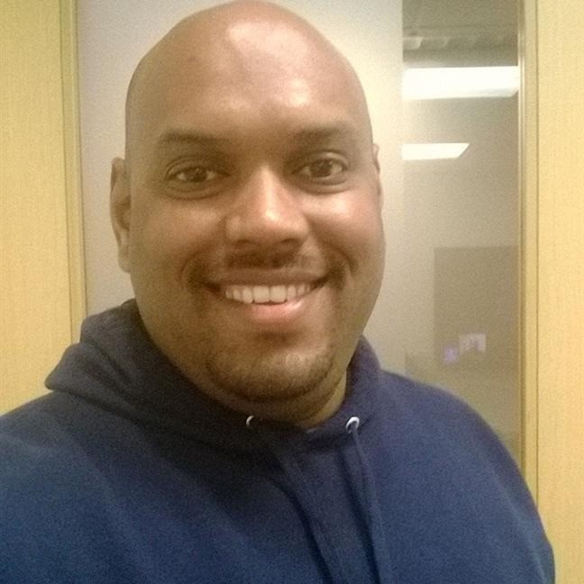
Instructors
Abid Nazir Guroo
Senior Product Manager,
Customer Advisory Team
Estera Kot, PhD
Principal Product Manager,
Fabric DE&DS Product Group
Venk Titte
Principal Product Manager,
Customer Advisory Team

Slide 3
Category | Description
Workshop Format | This is a hands-on workshop. You’ll be actively involved in coding, implementing, and problem-solving.
What to Expect | Real-world scenarios and exercises. Direct application of concepts in live environments.
Participant Engagement | Please have your laptops and necessary tools ready. Prepare to code, collaborate, and share insights.
Hands-on | Please delve into the detailed descriptions provided for each exercise and step. Examine the attached screenshots carefully, and note the sequential visualization presented as 1), 2), 3). Review them thoroughly.
Support and Collaboration | Instructors and facilitators are here to guide you. Feel free to ask questions and help your fellow participants.
Outcome | By the end of this workshop, you'll have practical experience and new skills to apply directly to your projects.

Slide 4
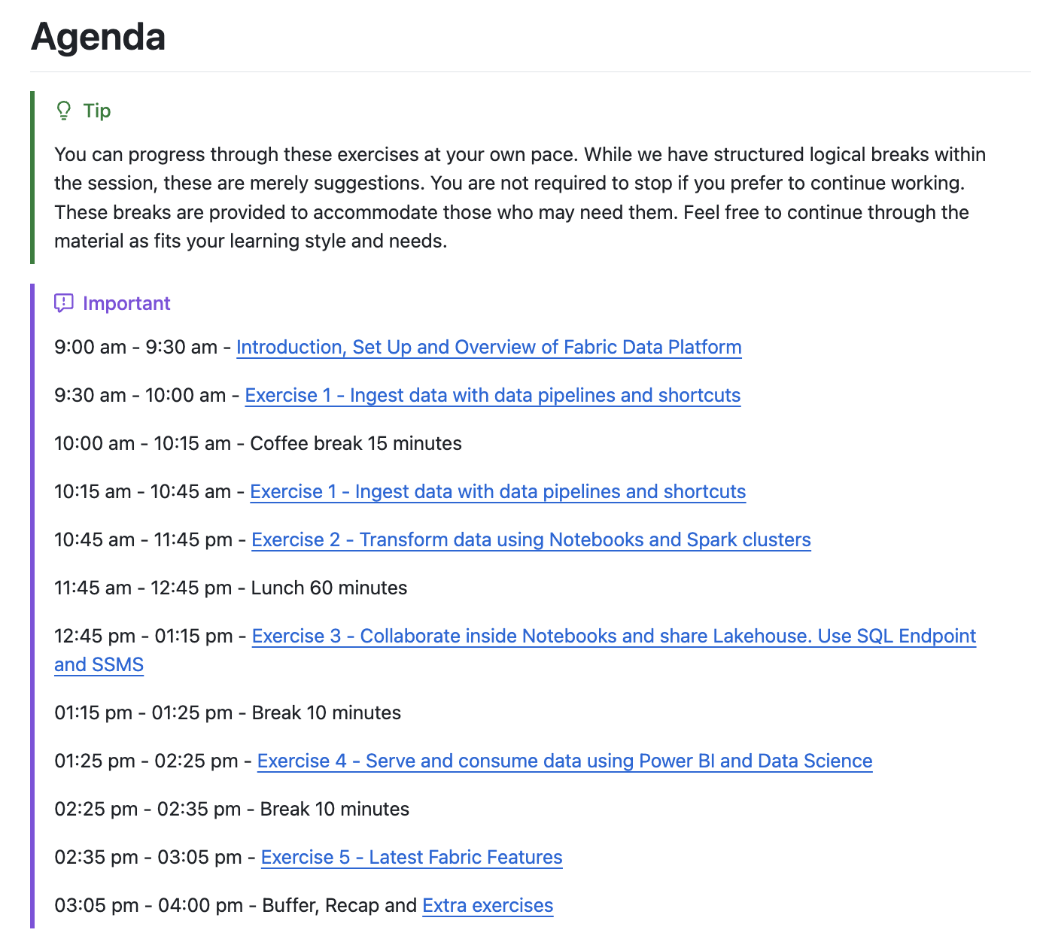
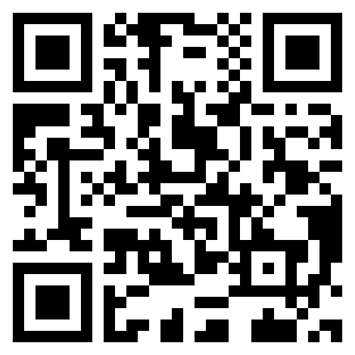
https://aka.ms/fabconlake

Slide 5
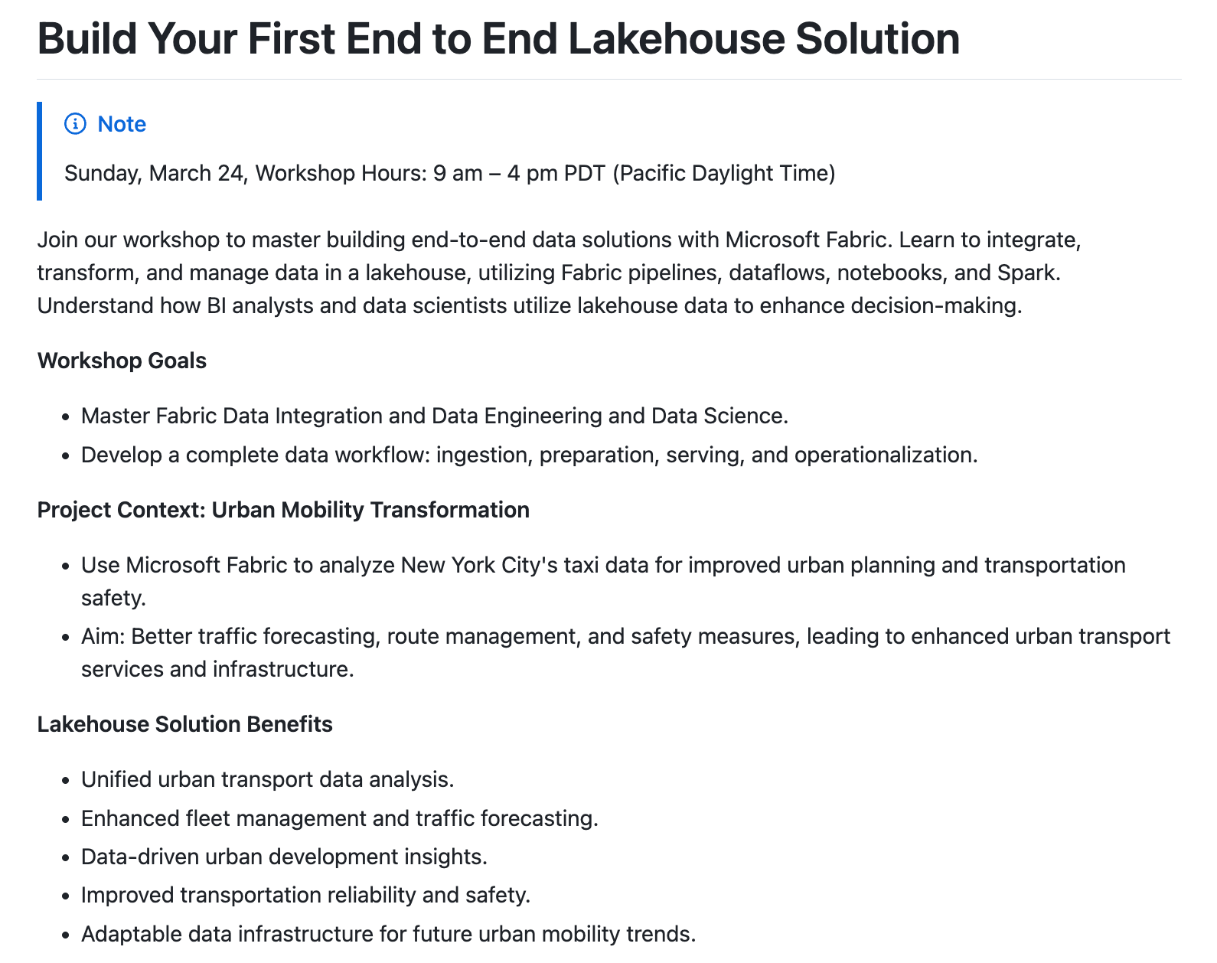
https://aka.ms/fabconlake

Slide 6
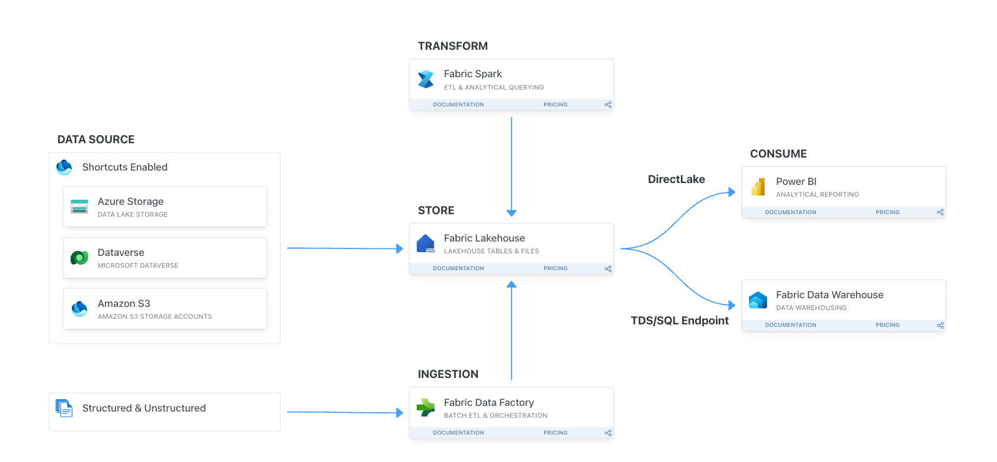
https://aka.ms/fabconlake

Slide 7
Enjoy, experience, network and learn!

Slide 8
Three Questions

Slide 9
Raise your hand if you have ever tried Microsoft Fabric before. This could be in any context, just any prior exposure at all.
#1

Slide 10
Raise your hand if you have explored more than three contexts within Fabric, such as Power BI, Data Science, Data Factory, or Data Engineering.
#2

Slide 11
Raise your hand if you, or your company, have faced challenges with orchestrating and integrating different tools to ingest, process, and maximize the value from data.
#3

Slide 12
Step 0: Start
Set Up and Overview of Fabric Data Platform

Slide 13
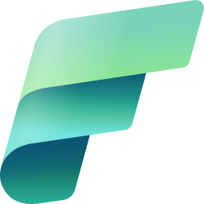





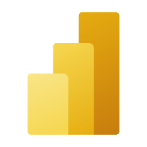
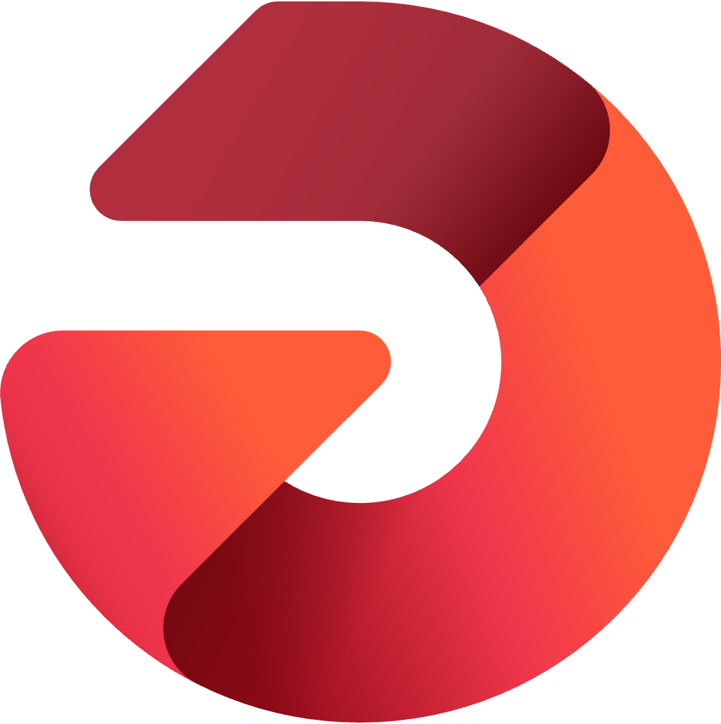



Microsoft Fabric
The unified data platform for the era of AI
Data
Factory
Synapse Data
Engineering
Synapse Data
Science
Synapse Data Warehousing
Synapse Real Time Analytics
Power BI
Data Activator
AI
OneLake
Purview
Unified
architecture
Unified experience
Unified governance
Unified business model

Slide 14
OneLake for all data
“The OneDrive for data”
A single SaaS lake for the whole organization
Data
Factory
Synapse Data
Engineering
Synapse Data
Science
Synapse Data Warehousing
Synapse Real-Time Analytics
Power BI
Data Activator
Provisioned automatically with the tenant
All workloads automatically store their data in the OneLake workspace folders
OneLake
All the data is organized in an intuitive hierarchical namespace
The data in OneLake is automatically indexed for discovery, MIP labels, lineage, PII scans, sharing, governance, and compliance
Intelligent data foundation

Slide 15
Exercise 1
Ingest data with data pipelines
and shortcuts

Slide 16
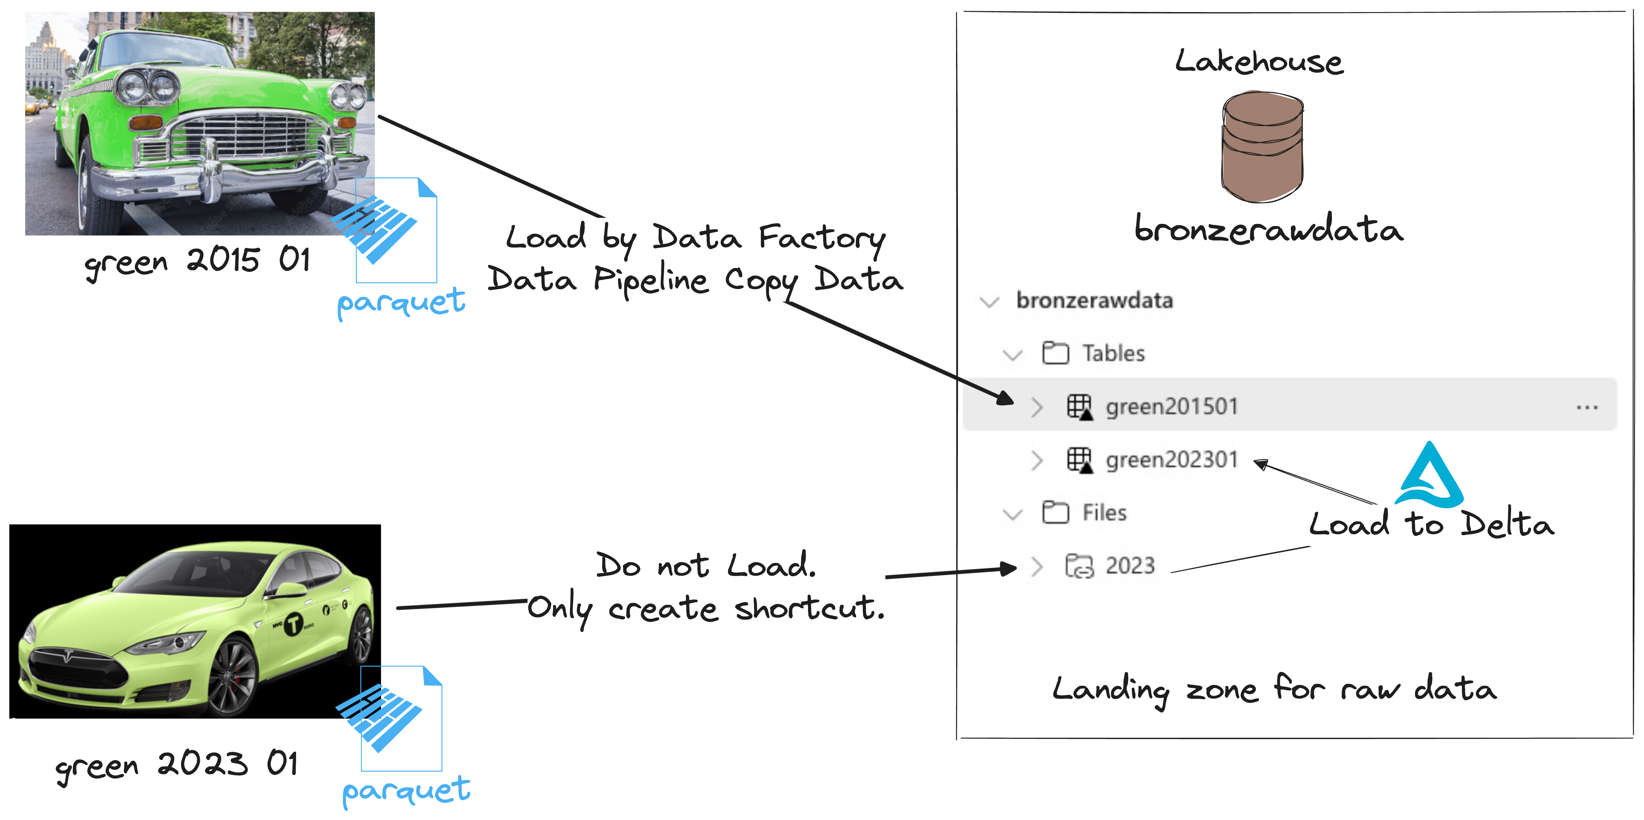
Exercise 1
Ingest data with data pipelines and shortcuts

Slide 17
Break 15’
Grab a coffee, stretch your legs, and get ready for the upcoming challenges!

Slide 18
Exercise 2
Transform data using Notebooks and Spark clusters

Slide 19
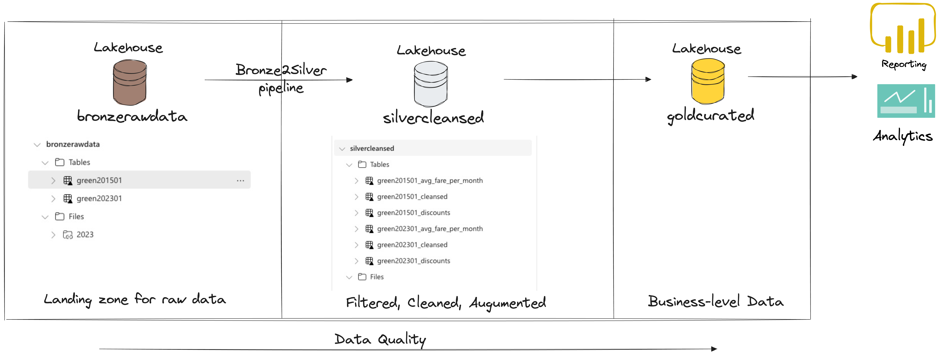
Exercise 2
Transform data using Notebooks and Spark clusters

Slide 20
Lunch break 60’

Slide 21
Exercise 3
Collaborate inside Notebooks and share Lakehouse. Use SQL Endpoint and SSMS

Slide 22
Break 5’
Grab a coffee, stretch your legs, and get ready for the upcoming challenges!

Slide 23
Exercise 4
Serve and consume data using Power BI and Data Science

Slide 24

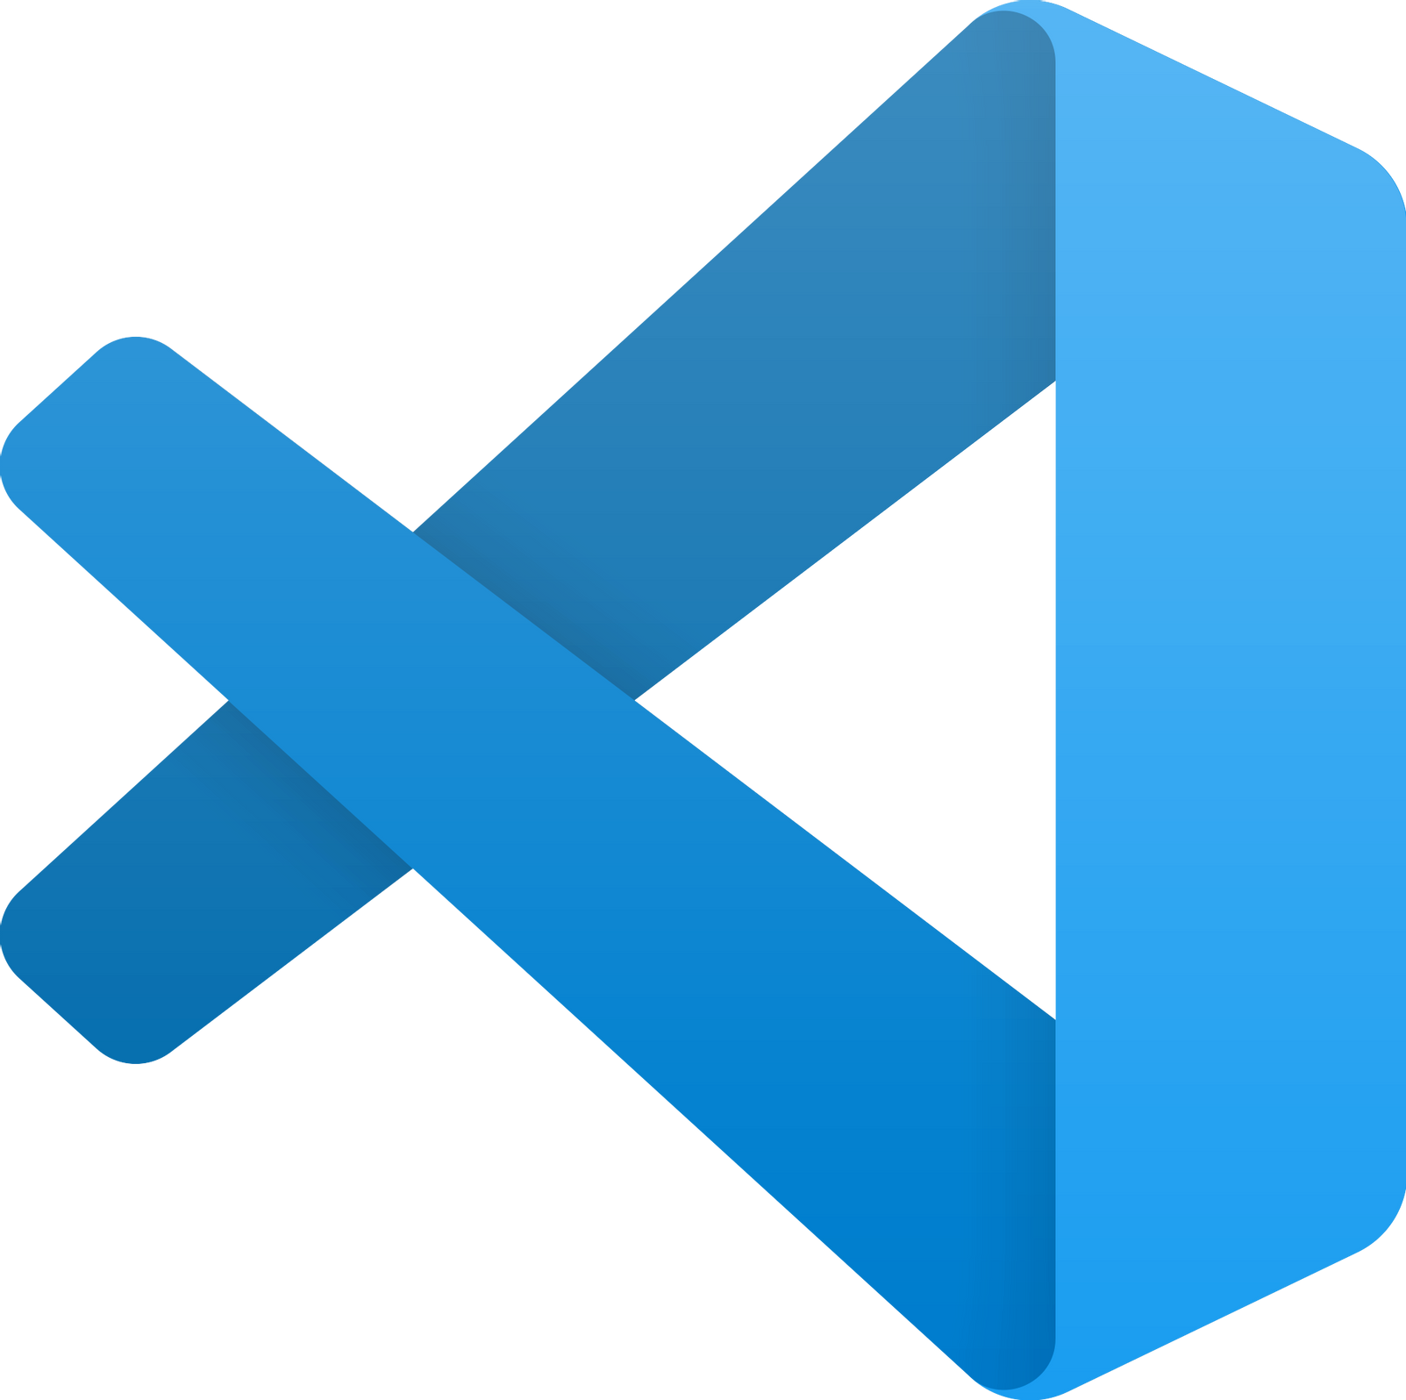
Data science in Microsoft Fabric End-to-end data science for predictive business insights
Developer friendly
SaaS experiences with quick setup
Code authoring experiences in Notebooks and IDE
VS Code integration
Rich ML tools
Supports MLFlow model and experiment management
Built-in, scalable ML tools with SynapseML
Direct Lake mode for serving predictions to BI reports
Promotes collaboration
Unified platform for all analytics roles incl. data scientists
Secure and easy sharing of data, code, models and experiments
Data Centric
Easy and secure access to lake-centric data
Open Delta Lake support promotes reproducibility
Native integration with data infrastructure
Notes:
Data Centric:
• Manage data in MS Fabric • Build from Data Lakes to PowerBI
• Open Delta Lake for reproducibility
• Integrate Machine Learning with data infrastructure
Section 2: Developer Friendly:
• Easy to use serverless infrastructure
• Delightful code authoring experiences in Notebooks
• Integration with popular IDEs like VS Code
Section 3:
Rich and Scalable ML:
• Built-in MLFlow model and experiment tracking
• MLFlow Autologging to track parameters and metrics
• SynapseML library on Spark for building and deploying models
• PBI Direct Lake Mode to serve predictions to Power BI Section
4: Streamlined Collaboration:
• Unified Platform for analytics roles
• Securely share data, code, models, and experiments
• Easier collaboration across the team

Slide 25





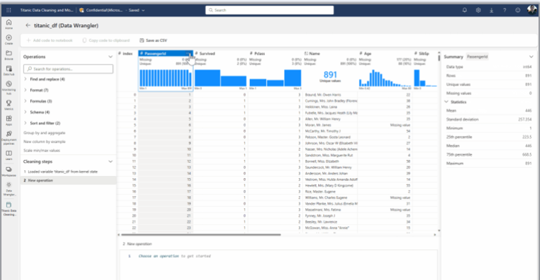
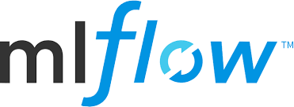

The Fabric Data Science experience
Problem formulation/ideation
Experiment and Model
Insight
SynapseML
Data discovery and pre-processing
Prepare
Model
Enrich and
Operationalize
Explore
Evaluate
Batch
PREDICT
Direct Lake
Data Wrangler
Notes:
We have a key scenario defined for Public Preview
Goal is to make this as smooth as possible
Not only scenario
Now let’s look at some experiences and features we ar eenabling

Slide 26
Exercise 4
Serve and consume data using Power BI and Data Science

Slide 27
Break (up to 3:05 PM)
Grab a coffee, stretch your legs, and get ready for the upcoming challenges!

Slide 28
Exercise 5
Latest Fabric Features (DE side)

Slide 29
Workshop recap

Slide 30
Thank you

Slide 31
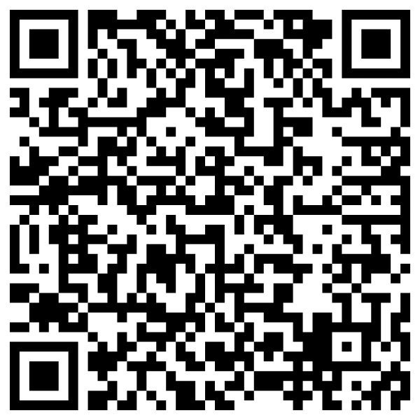
Become a Fabric Analytics Engineer
Visit the Fabric Career Hub!
Discount on DP-600 Exam
100%
OFF
LIMITED TIME ONLY
aka.ms/FabricCareerHub
Become eligible for a free Microsoft Certification exam by completing one of the 4 challenges in the Microsoft Learn AI Cloud Skills Challenge.

Slide 32




Engage with the Fabric Community…
aka.ms/FabricCommunity
Ask and answer questions in the Fabric Community forum
there’s something for everyone!
aka.ms/FabricUserGroups
Find a user group in your area or to match your interests
Community Lounge Meet Ups
Check Whova for official meetups with user group leaders, MVPs, Super Users and more!
Meet Speakers & the Product Group
Check Whova for the full schedule of speaker Q&A and PG meet & greets in the Community Lounge.

Slide 33
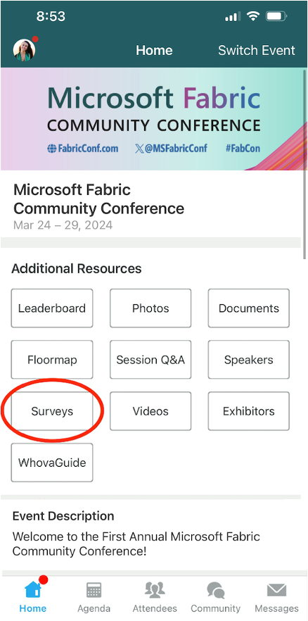
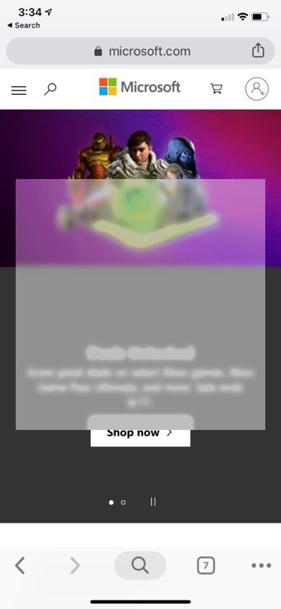
Session feedback surveys
We really want to hear from YOU!
In the pursuit of making next year’s Microsoft Fabric Community Conference even better, we want to hear your feedback about this session.
Here’s how easy it is!
1
Simply go to the Whova App on your smartphone
Scroll down on the Microsoft Fabric Community Conference Homepage to ‘Additional Resources’ to click ‘Surveys’
Click Session Feedback
Scroll down to find this session title
Complete the session feedback survey
Finally, click ‘Submit’
2
3
4
5
6

Slide 34
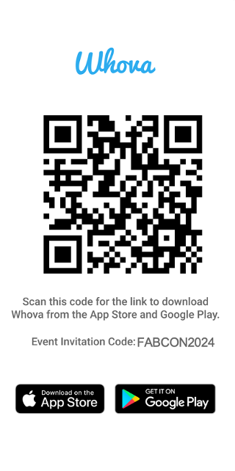

EVENT INVITATION CODE FABCON2024
The official event app for the
Microsoft Fabric Community Conference
Join the event app to access:
Event announcements
Event documents
Personalized agenda, session details
Networking, meet-ups, messages
Speaker & attendee profiles

Slide 35
